Slide 1
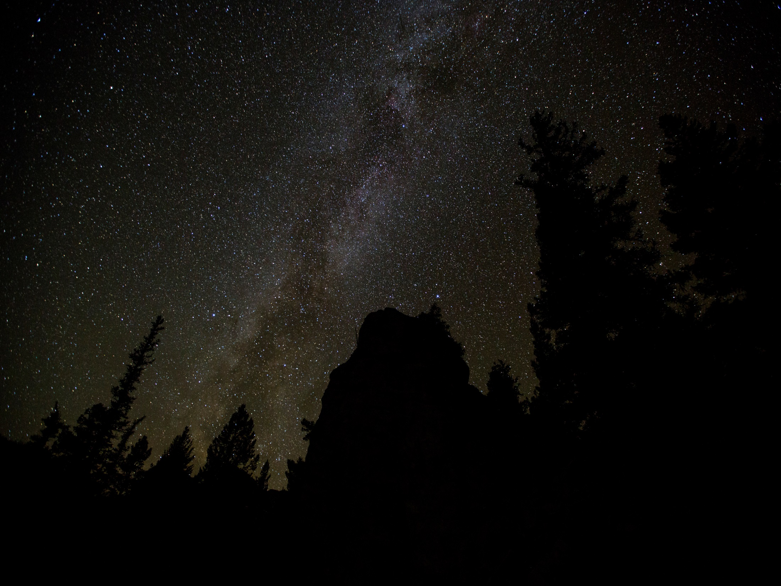
Workout Summary
Time
1:21:30
Distance (miles)
5.6
Enter name of new statistic. . .
seconds
Add New
Save

